Slide 1
Lecture 25 – 2-3 Trees
CST370 – Design & Analysis of Algorithms
Dr. Byun
Computer Science

Slide 2
Lecture Objectives
After completion of this lecture, you will be able to
  explain the definition of a 2-3 tree and conduct insertion operations to it.

Slide 3
Chapter 6: Transform-and-Conquer
6.1 Presorting
6.2 Gaussian Elimination
6.3 Balanced Search Trees
6.4 Heaps and Heapsort
6.5 Horner’s Rule and Binary Exponentiation
6.6 Problem Reduction

Slide 4
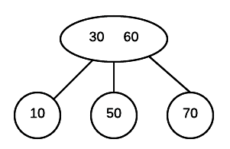
2-3 Trees
A 2-3 tree is a search tree.
  Each node can have one or two values.
  All leaves of a 2-3 tree are at the same level.
Example

Slide 5
<<< Course Instruction >>>
Watch this video from the beginning to 6:57.
  http://y2u.be/vSbBB4MRzp4

Slide 6
Exercise

Slide 7
2-3 Tree Construction: Example
Construct a 2-3 tree for the list 9, 5, 8, 3, 2, 4, 7.

Slide 8
Exercise
Construct a 2-3 tree for the list 1, 2, 3, 4, 5, 6, 7,8

Slide 9
Another Resource
Watch this video from 6:48 to 10:22 for the construction of a 2-3 tree with the numbers 5, 10, 20, 8, 7, 15, 30, and 11.
  https://goo.gl/Kd7k1o

Slide 10
Analysis of 2-3 Trees
Search, insertion, and deletion operations take O(log n).
“2-3-4 tree” is also available.

